Slide 1
Photosynthesis and Cellular Respiration Kit for General Biology Modifications for Socially-Distanced Classrooms
Use premade algae beads to help dispel the common misconception that plants only photosynthesize and only animals perform cellular respiration — these unicellular algae do both! Students investigate both processes together and design their own experiments to determine the conditions under which each process is dominant.
Each kit is designed for 24 workstations of 4 students. Each uses 2 sets of 3 algae beads in tubes with CO₂ indicator solution to observe both processes in parallel.
The curriculum includes:
Students use CO₂ indicator solution to observe a phenomenon and make predictions.
Students extract algae from beads and investigate under a microscope.
Students use algae beads to explore their predictions.
Modifications for At-Home Use
Use the online resources available at bio-rad.com/classroomresources.
Provide CO₂ indicator solution (10 ml in a 15 ml tube - not included) and a straw.
Do not perform debeading/microscopy activity.
Provide additional CO₂ indicator and distilled water (optional, requires additional plastics).
- CO₂ indicator solution (10 ml in a 15 ml tube, not included).
- Distilled water (10 ml in a 15 ml tube, not included) to rinse pipets.
Modifications to extend number of stations
Students use 1 tube of algae beads to observe both processes in sequence rather than in parallel.
Ordering Information
12005534EDU Photosynthesis and Cellular Respiration Kit for General Biology
1660475EDU 15 ml Conical centrifuge tubes (50)
To see our solutions for other kits…
Download the guide Solutions for Socially-Distanced Classrooms

Slide 2
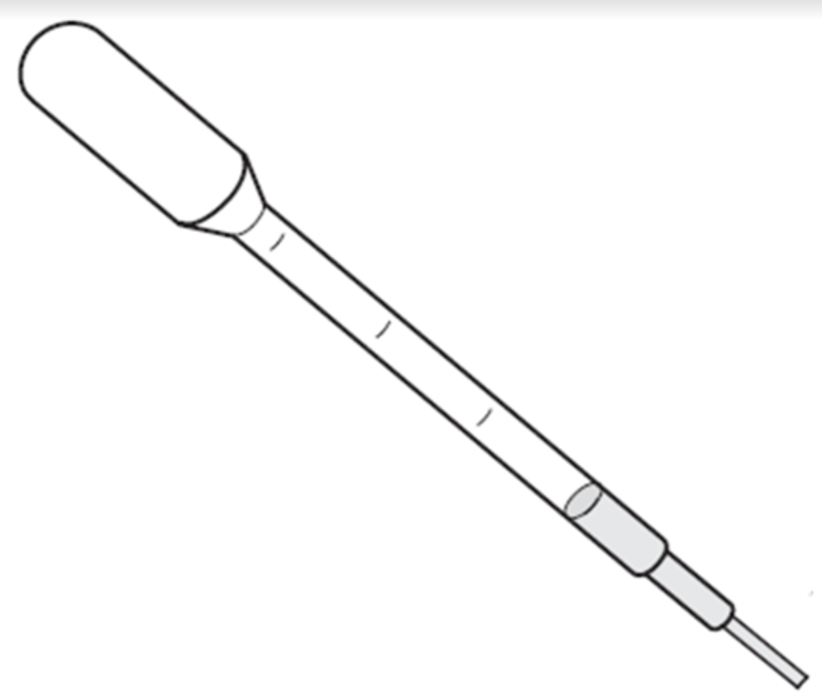
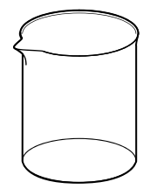
Photosynthesis and Cellular Respiration Kit for General Biology Modified Teacher Preparation Guide – Classroom Use
Download the Photosynthesis and Cellular Respiration Kit for General Biology Manual. Follow the teacher prep instructions on pages 14-28 with the modifications noted below.
Prep (pg. 14-18)
Prep as directed, making 1 workstation per student.
Lesson 1 Workstations (pg. 19)
Instead of splitting the students into groups of 4, make one workstation per student.
Lesson 2 Workstations (pg. 25-26)
Set up a teacher demo station as directed in manual. Demo the supplies for students.
Lesson 3 Workstations (pg. 27-28)
Lesson 3 Workstations (pg. 27-28)
15 indicator color guides are included in the kit. Make additional color copies or provide students with digital versions.
Give each student a small cup or beaker with distilled water to rinse their disposable pipet between uses.
Lab space: classroom
Number of workstations: 28
Additional Materials Required
3 Small disposable cups or beakers
Lamp or flashlight (students can share or use their cell phone flashlights)
1 indicator guide – can be color copied or provided digitally
1 permanent marker
Optional: 1 straw – can also use disposable pipets with bulb cut
2 PCR tubes with 3 algae beads, filled with CO₂ indicator
2 empty PCR tubes
1 small cup with 5 ml CO₂ indicator
1 disposable pipet
1 cup or beaker with distilled water
1 piece of aluminum foil (about 3”x3”)
1 indicator color guide (paper or digital)
1 marking pen

Slide 3
Photosynthesis and Cellular Respiration Kit for General Biology Modified Teacher Preparation Guide – At-Home Use
Download the Photosynthesis and Cellular Respiration Kit for General Biology Manual. Follow the teacher prep instructions on pages 14-28 with modifications noted below.
Prep (pg. 14-18)
Prep as directed, making 1 workstation per student.
Lesson 1 Workstations (pg. 19)
Instead of splitting the students into groups of 4, make one workstation per student.
Lesson 2 Workstations (pg. 25-26)
Set up a teacher demo station as directed in manual. Demo the supplies for students.
Lesson 3 Workstations (pg. 27-28)
15 indicator color guides are included in the kit. Make additional color copies or provide students with digital versions.
Provide 10 ml 1x CO₂ indicator solution in a 15 ml tube for each student. They will use 5 ml for Lesson 1 and 5 ml in Lesson 3.
Fill another 15 ml tube with distilled water for each student. They can use this water for rinsing their pipet between uses.
Lab space: at home
Number of workstations: 28
Additional Materials Required (per student)​
Provided By Teacher
2 15 ml tubes for CO₂ indicator solution (not provided in kit, order 1660475EDU,qty 50)
1 indicator guide – can be color copied or provided digitally
Optional: 1 straw – can also use disposable pipets with bulb cut
Provided By Student
3 Small cups
Permanent marker
Lamp, flashlight, or cell phone flashlight
2 PCR tubes with 3 algae beads, filled with CO₂ indicator
2 empty PCR tubes
1 15 ml tube with 10 ml indicator solution
1 15 ml tube with distilled water
1 piece of aluminum foil (about 3”x3”)
1 indicator color guide (paper or digital)
1 marking pen
1 disposable pipet

